Slide 1
Sortari
Stefanoiu Rares Andrei

Slide 2
Test 8

Slide 3
Counting Sort
Timpi de executie:
N=10 Max=100000000 : 0.751667secunde
N=100 Max=10000000: 0.632263secunde
N=1000 Max=1000000: 0.010414secunde
N=10000 Max=100000: 0.001479secunde
N=100000 Max=10000: 0.002822secunde
N=1000000 Max=1000: 0.008359secunde
N=10000000 Max=100: 0.094914secunde
N=100000000 Max=100000000: 11.7502secunde

Slide 4
Counting sort
Complexitate: O(n+k) k-cel mai mare numar
Este cel mai eficient algoritm pe testele mari (test 8) si pe cele in care k<n (test 7) , dar este extrem de ineficient pe testele in care k>=n^2 (testul 1).

Slide 5
Merge Sort
N=10 Max=100000000: 3microsecunde
N=100 Max=10000000: 18microsecunde
N=1000 Max=1000000: 0.000458secunde
N=10000 Max=100000: 0.005153secunde
N=100000 Max=10000: 0.043986secunde
N=1000000 Max=1000: 0.383996secunde
N=10000000 Max=100: 2.74538secunde
N=100000000 Max=100000000: 43.197secunde

Slide 6
Merge sort
Complexitate: O(nlogn)
Este de viteza aproximativ egala cu shell sort pe testele cu numar mai mic de elemente, dar este rapid pe testele cu numar mare de elemente
(test 8).

Slide 7
Shell Sort
N=10 Max=100000000: 1microsecunde
N=100 Max=10000000 : 26microsecunde
N=1000 Max=1000000: 0.000409secunde
N=10000 Max=100000: 0.005303secunde
N=100000 Max=10000: 0.05616secunde
N=1000000 Max=1000: 0.477778secunde
N=10000000 Max=100: 2.41322secunde
N=100000000 Max=100000000: 104.864secunde

Slide 8
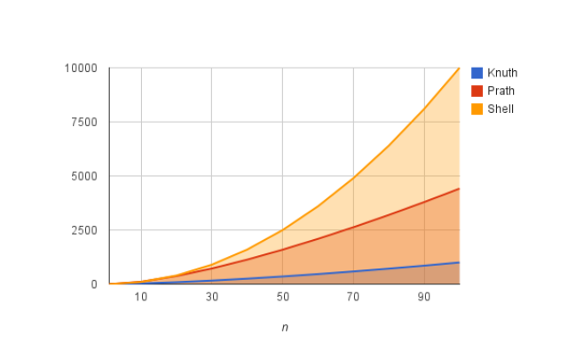
Shell Sort
Complexitate: O(n^(3/2)) (Knuth sequence)
Este putin mai lent fata de merge sort

Slide 9
Radix sort(baza 10)
N=10 Max=100000000: 24microsecunde
N=100 Max=10000000: 0.000111secunde
N=1000 Max=1000000: 0.000763secunde
N=10000 Max=100000: 0.006639secunde
N=100000 Max=10000: 0.043626secunde
N=1000000 Max=1000: 0.245233secunde
N=10000000 Max=100: 1.615536secunde
N=100000000 Max=100000000: 45.7138secunde

Slide 10
Radix sort
Complexitate: logb (k) *(n+min(k,b))
k-numarul maxim
b-baza
Bazele mari se descurca mult mai bine pe testele lungi cu numere mari
Test 8

Slide 11
Heapsort
N=10 Max=100000000: 2microsecunde
N=100 Max=10000000: 0.000195secunde
N=1000 Max=1000000: 0.00138secunde
N=10000 Max=100000: 0.013686secunde
N=100000 Max=10000: 0.102487secunde
N=1000000 Max=1000: 1.76876secunde
N=10000000 Max=100: 13.288secunde
N=100000000 Max=100000000: 223.688secunde
Complexitate: O(nlogn)
Este cel mai lent algoritm dintre cei alesi

Slide 12
Sort
N=10 Max=100000000: 47microsecunde
N=100 Max=10000000: 0.000268secunde
N=1000 Max=1000000: 0.001407secunde
N=10000 Max=100000: 0.011071secunde
N=100000 Max=10000: 0.094129secunde
N=1000000 Max=1000:0.561513secunde
N=10000000 Max=100: 3.95106secunde
N=100000000 Max=100000000: 125.316secunde
Complexitate:O(NlogN)

